Slide 1
How ISIS Uses Twitter
By Alexander M. Babenchuk

Slide 2
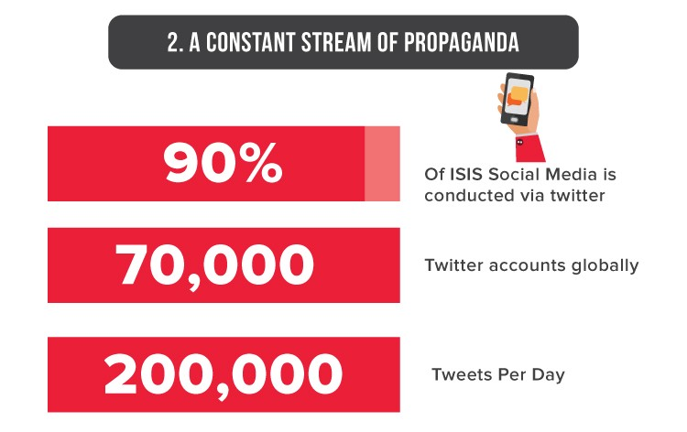
Why?
ISIS is very good at broadcasting and radicalizing on Twitter:
Twitter responds by shutting down 360,000 accounts.

Slide 3
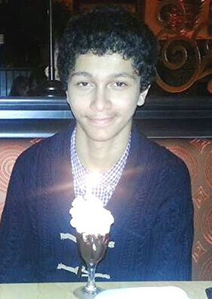
ISIS is too good at Twitter…
Ali Shukri Amin a 17 year old H.S. student from Virigina.
Sentenced to over 11 years in prison
Radicalized by ISIS.
Amin ran a Twitter account @AmreekiWitness
Over 4,000 followers
Tweeter over 7,000 messages
Helped a friend join ISIS to fight in Syria.

Slide 4


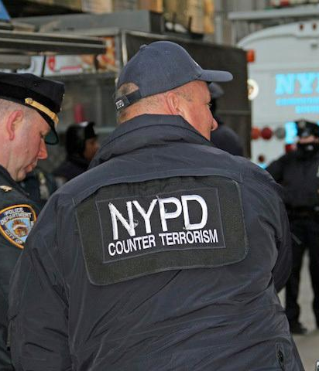


Who Cares?
His parents!

Slide 5
Data Story…
Not a lot of data…
Most from 2016

Slide 6
Data Story…
Top users, hashtags and keywords
Most are very general and appear in both pro-ISIS and anti-ISIS tweets

Slide 7
Data Story…
username | n_followers | n_tweets | % of tweets
Uncle_SamCoco | 1809 | 1580 | 18%
RamiAlLolah | 34692 | 1475 | 17%
warrnews | 7566 | 1191 | 14%
WarReporter1 | 2632 | 1095 | 13%
mobi_ayubi | 965 | 1056 | 12%
_IshfaqAhmad | 1667 | 709 | 8%
wayf44rerr | 1398 | 405 | 5%
Nidalgazaui | 4662 | 397 | 5%
MaghrabiArabi | 353 | 366 | 4%
melvynlion | 81 | 348 | 4%
Just a few loud voices
With lots of followers
Posting tweets under the pretense of news
tweets.hash | Qty
#ISIS | 724
#IS | 398
#Syria | 348
#AmaqAgency | 283
#BreakingNews | 244
#IslamicState | 180
#Iraq | 172
#Breaking | 164
#Aleppo | 129
#USA | 125
#Russia | 119
#BREAKING | 111

Slide 8
Dendrogram
Shows the association of words based on clusters.
Sums up 17k tweets accurately.

Slide 9

Between the lines of data…
You don’t need to disable every account… just the popular ones.
Jigsaw’s “Redirect Method” is working.
Anonymous’ #OpISIS is working.
Twitter is no longer the primary method of broadcast or recruitment for ISIS, App named Telegram is…

